Slide 1
WEEK NINE: Accrual and Prepayment
Class 17 & 18
Cash Basis v. Accrual Accounting
Revenue Recognition principle; Matching principle
Accrual v. Prepayment
Should we record transactions only if cash is involved or as they occur?
When should Revenue be recognised? Should Expense timing match revenue?
Accounting for payment after revenue & expense (Accrual) or before (Prepayment)

Slide 2
Cash Basis v Accrual Accounting
Cash Basis accounting records transaction only if cash is involved
Accrual Accounting records transactions as they occur
Cash Basis: record cash receipts & payments. Ignore economic activity. For very small firms.
Accrual Accounting: record transactions as they occur, whether cash or not. IAS1 requires it.
Accrual Accounting records revenue when earned and expenses when incurred rather than when cash is received or paid. The timing difference leads to Accruals and Prepayments.
Notes:
Many other examples, e.g hotel bill paid on departure but flights paid in advance. Staff paid during next month and bonus pool accrued during year but rent and insurance paid in advance. Bond coupons paid semi-annually but interest expense accrued until payment made. Taxes usually paid in arrears, accrue taxes owed.

Slide 3
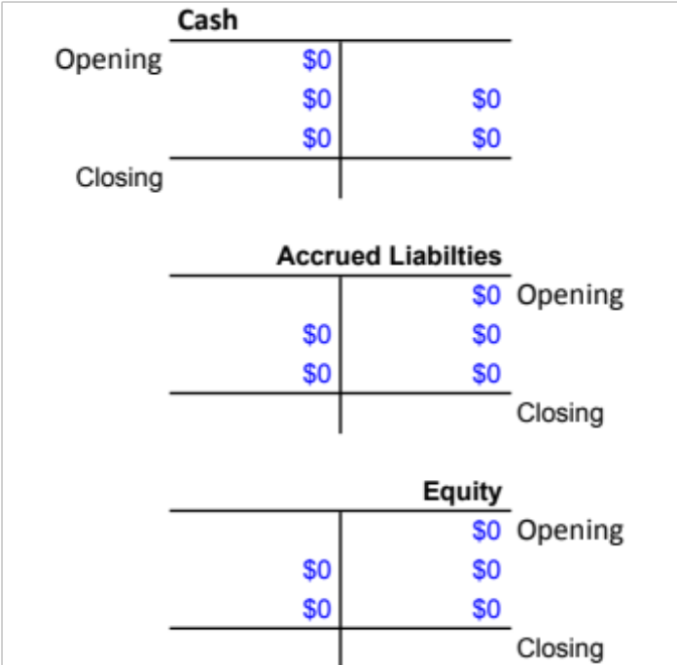
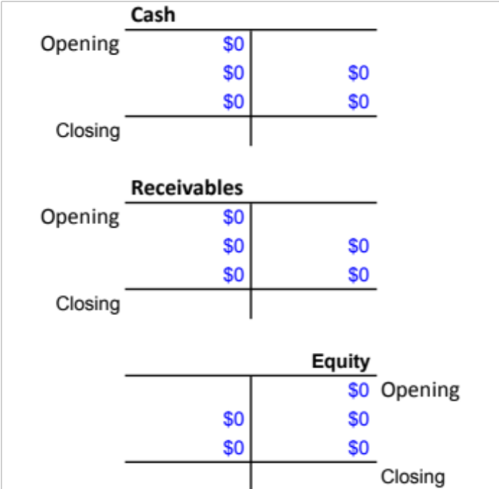
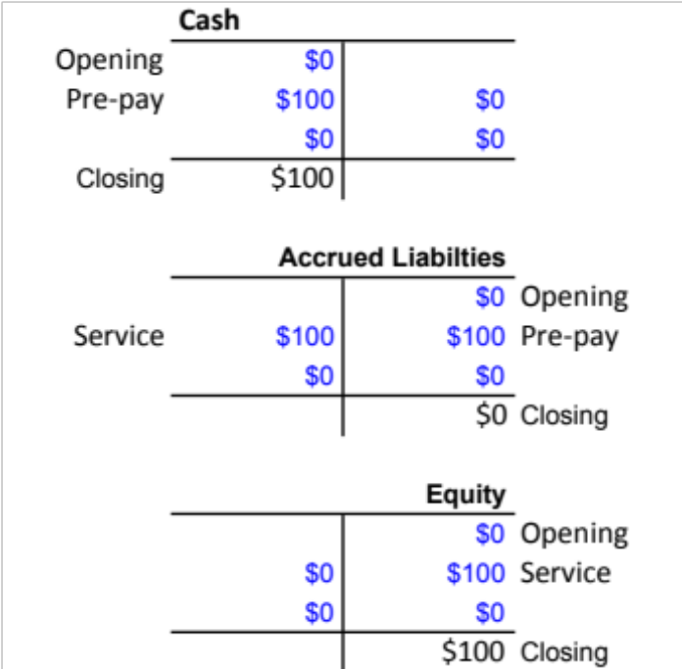
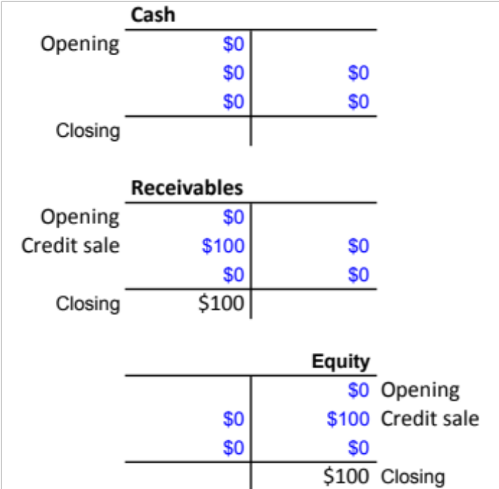
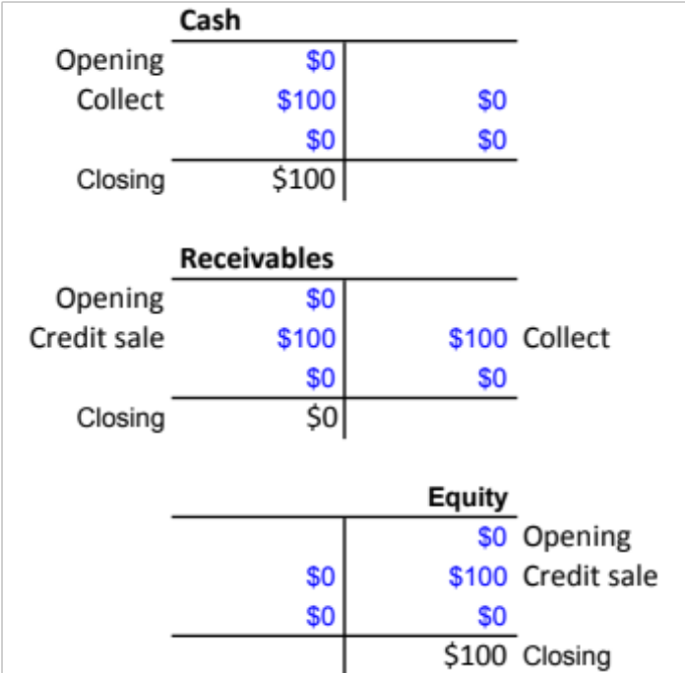
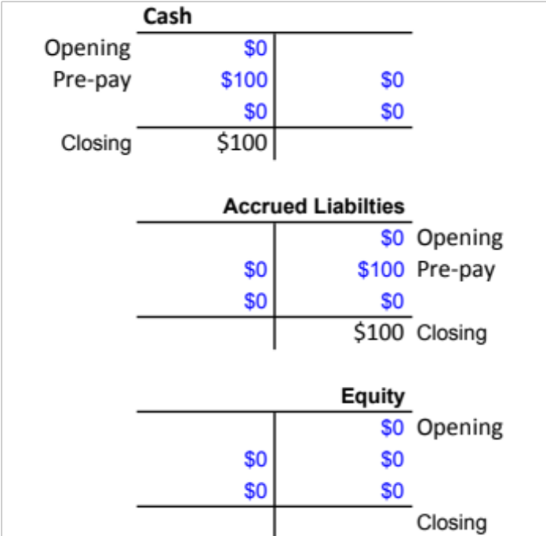
Revenue example
Accrued revenue (e.g. post-pay mobile): credit sale ... collect
Prepayment (e.g. pre-pay mobile): prepay (Cash, Accrued Liab.) ... service (AL, Equity)
  Unearned Revenue is an Accrued Liability as the firm is liable to provide the service
Accrued revenue (post-pay)
Prepayment
Notes:
Many other examples, e.g hotel bill paid on departure but flights paid in advance. Staff paid during next month and bonus pool accrued during year but rent and insurance paid in advance. Bond coupons paid semi-annually but interest expense accrued until payment made. Taxes usually paid in arrears, accrue taxes owed.

Slide 4
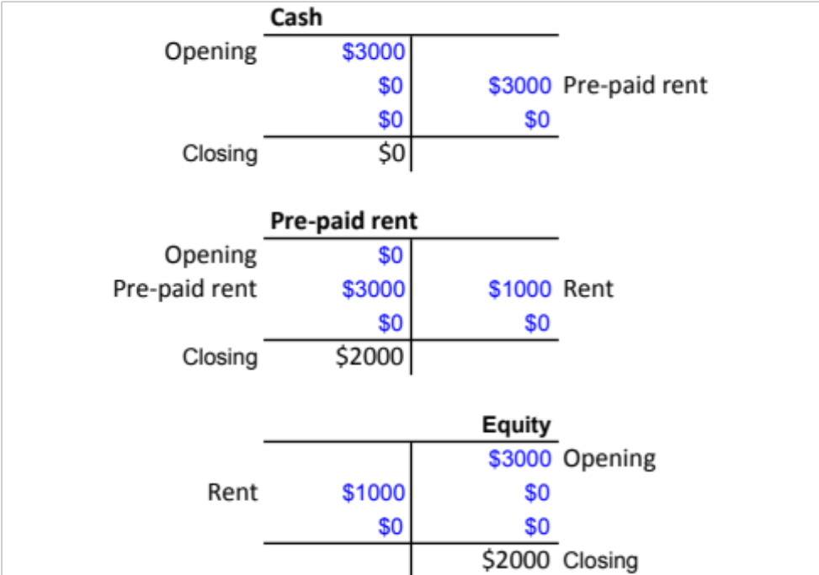
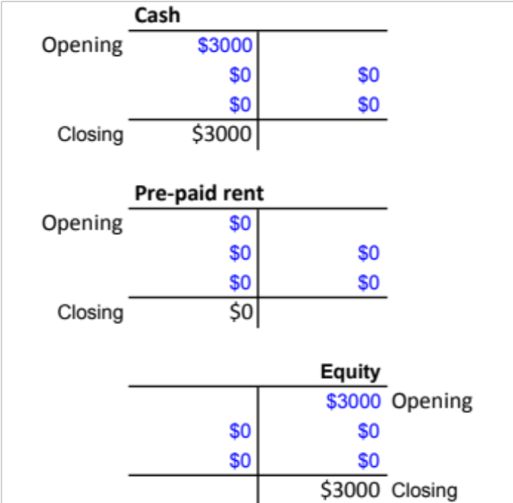
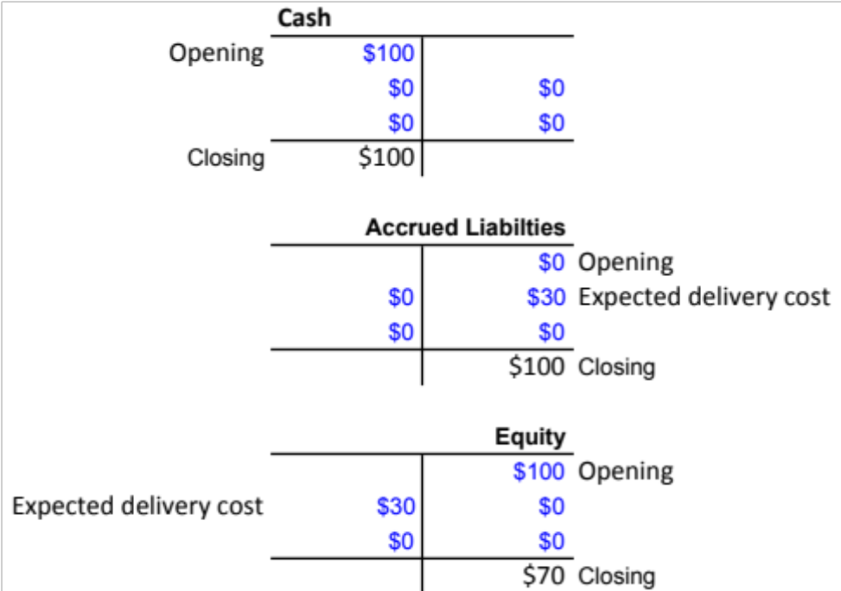
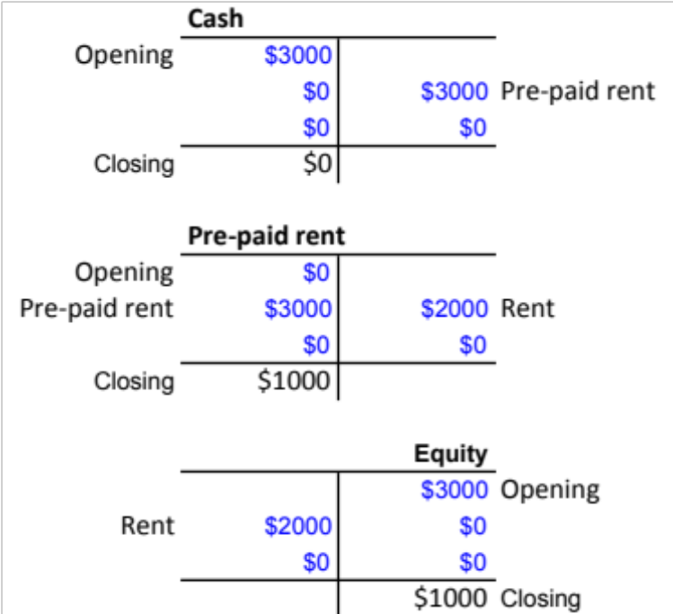
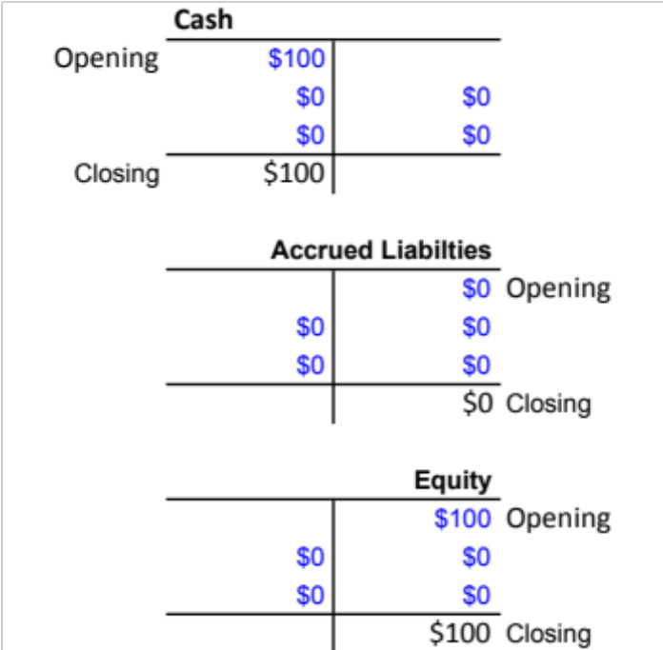
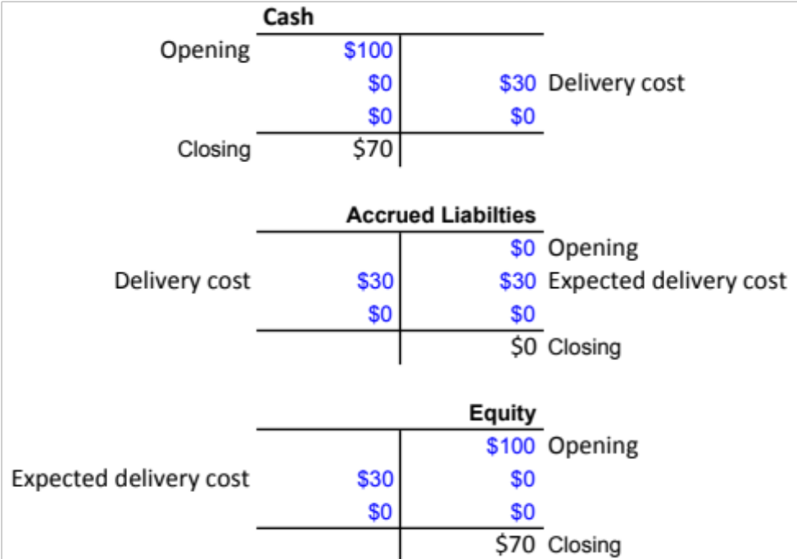
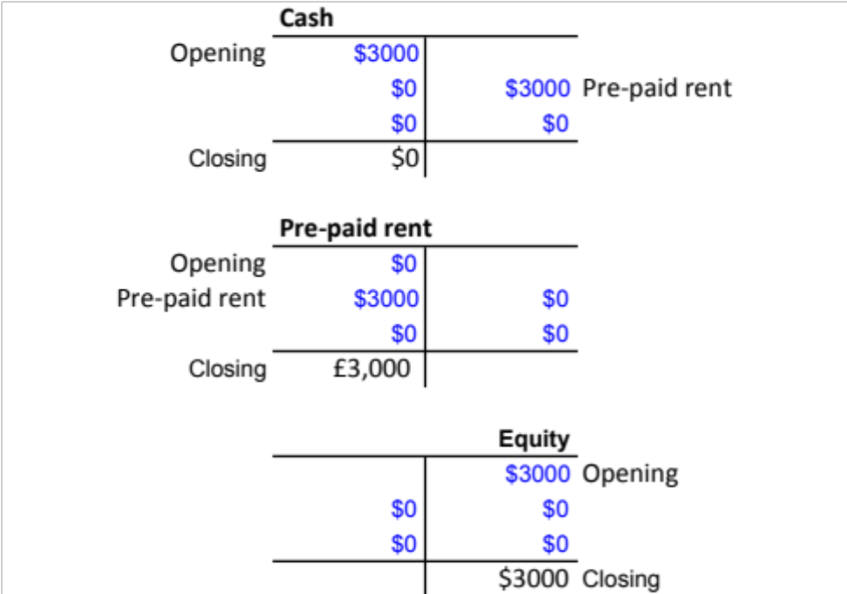
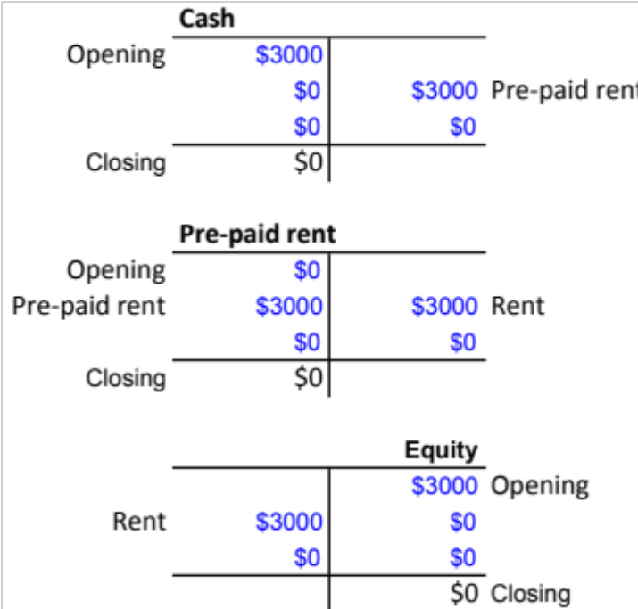
Expense example
Accrued expense (delivery cost): expected delivery cost ... delivery cost
Prepaid expense (rent): prepay 3 months ... rent ... rent ... rent
Accrue expense (delivery cost)
Prepay expense (rent) prepayment)
Notes:
Many other examples, e.g hotel bill paid on departure but flights paid in advance. Staff paid during next month and bonus pool accrued during year but rent and insurance paid in advance. Bond coupons paid semi-annually but interest expense accrued until payment made. Taxes usually paid in arrears, accrue taxes owed.

Slide 5
Revenue Recognition principle
The entity has transferred to the buyer the significant risks and rewards of ownership of the goods
The entity retains neither continuing managerial involvement to the degree usually associated with ownership nor effective control over the goods sold
The amount of revenue can be measured reliably
It is probable that the economic benefits associated with the transaction will flow to the entity
The costs incurred or to be incurred in respect of the transaction can be measured reliably
Notes:
The matching principle is the basis for recording and recognizing expenses. The IFRS Framework states that expenses recognized in the income statement on the basis of a direct association between the costs incurred and the earning of specific items of income. This process is commonly referred to as the “matching of costs with revenues”. Expenses have no future benefit to the company. The matching principle includes two steps:
1. Identify all the expenses incurred during the accounting period.
2. Measure the expenses, and match expenses against the revenues earned.
To match expenses against revenues means to subtract expenses from revenues to compute net income or net loss.
Some expenses are paid in cash. Other expenses arise from using up an asset such as supplies. When expenses are incurred but not yet paid, a company has a liability. The critical event for recording an expense is the employees’ working for the company, not the payment of cash.

Slide 6
Matching principle
The entity has transferred to the buyer the significant risks and rewards of ownership of the goods
The entity retains neither continuing managerial involvement to the degree usually associated with ownership nor effective control over the goods sold
The amount of revenue can be measured reliably
It is probable that the economic benefits associated with the transaction will flow to the entity
The costs incurred or to be incurred in respect of the transaction can be measured reliably
Identify expenses incurred
Measure the expenses
Match against the revenues earned
Notes:
The matching principle is the basis for recording and recognizing expenses. The IFRS Framework states that expenses recognized in the income statement on the basis of a direct association between the costs incurred and the earning of specific items of income. This process is commonly referred to as the “matching of costs with revenues”. Expenses have no future benefit to the company. The matching principle includes two steps:
1. Identify all the expenses incurred during the accounting period.
2. Measure the expenses, and match expenses against the revenues earned.
To match expenses against revenues means to subtract expenses from revenues to compute net income or net loss.
Some expenses are paid in cash. Other expenses arise from using up an asset such as supplies. When expenses are incurred but not yet paid, a company has a liability. The critical event for recording an expense is the employees’ working for the company, not the payment of cash.

Slide 7
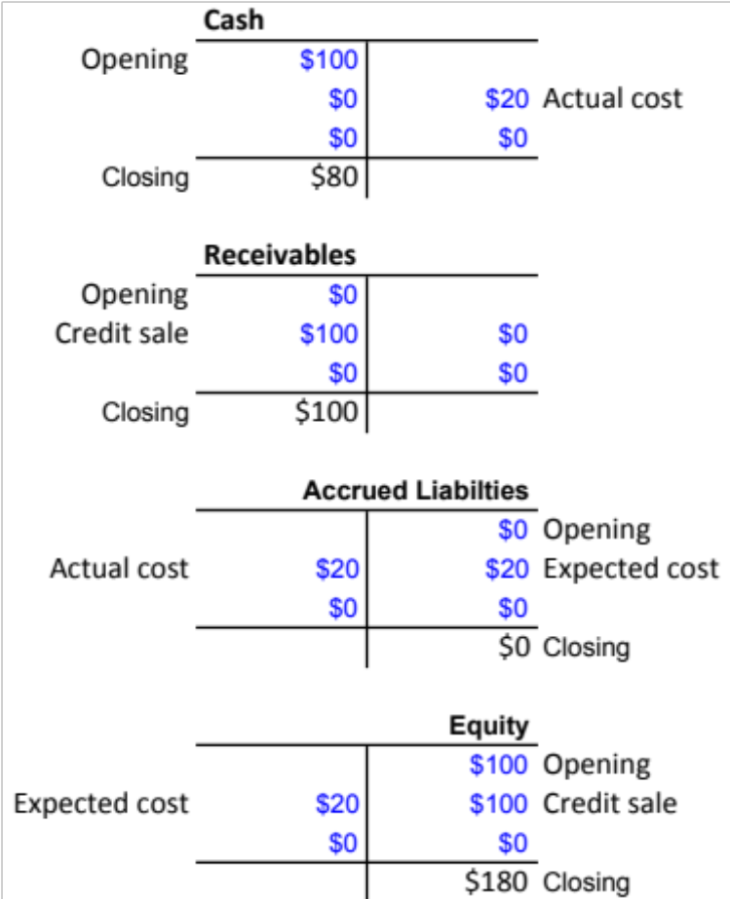
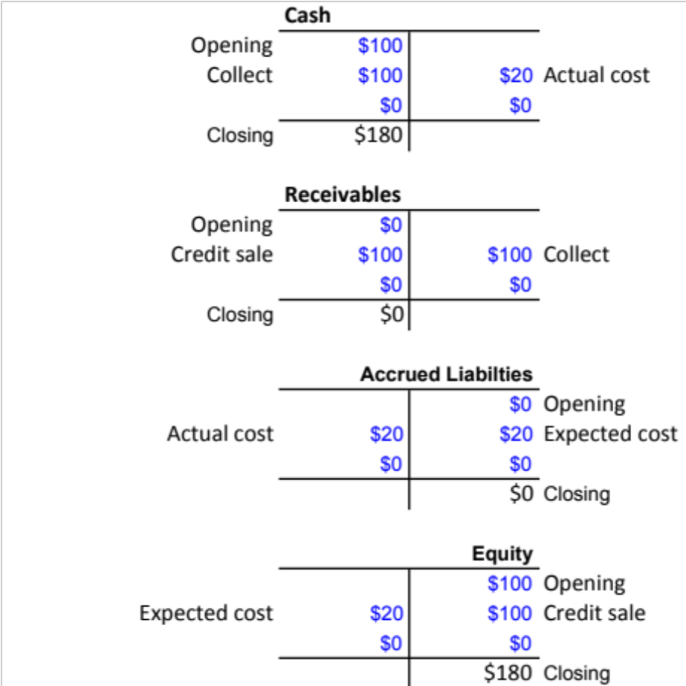
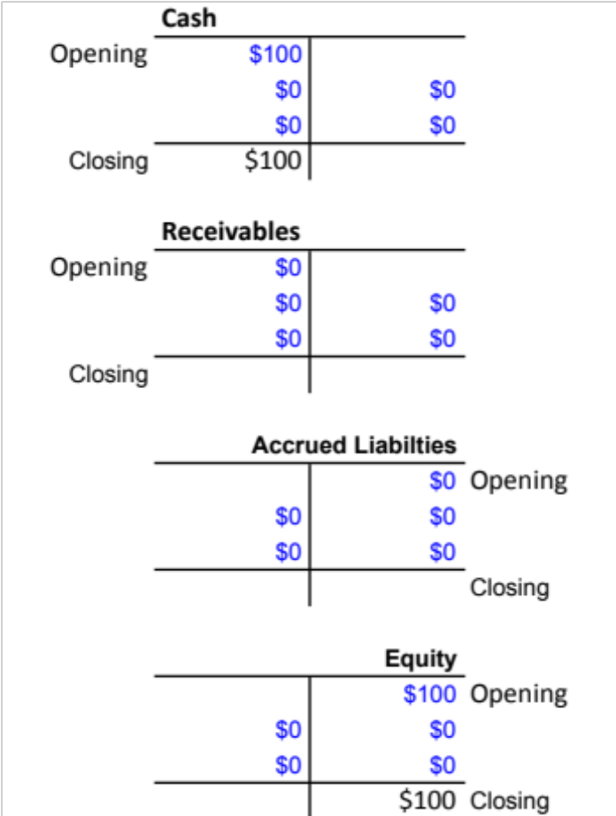
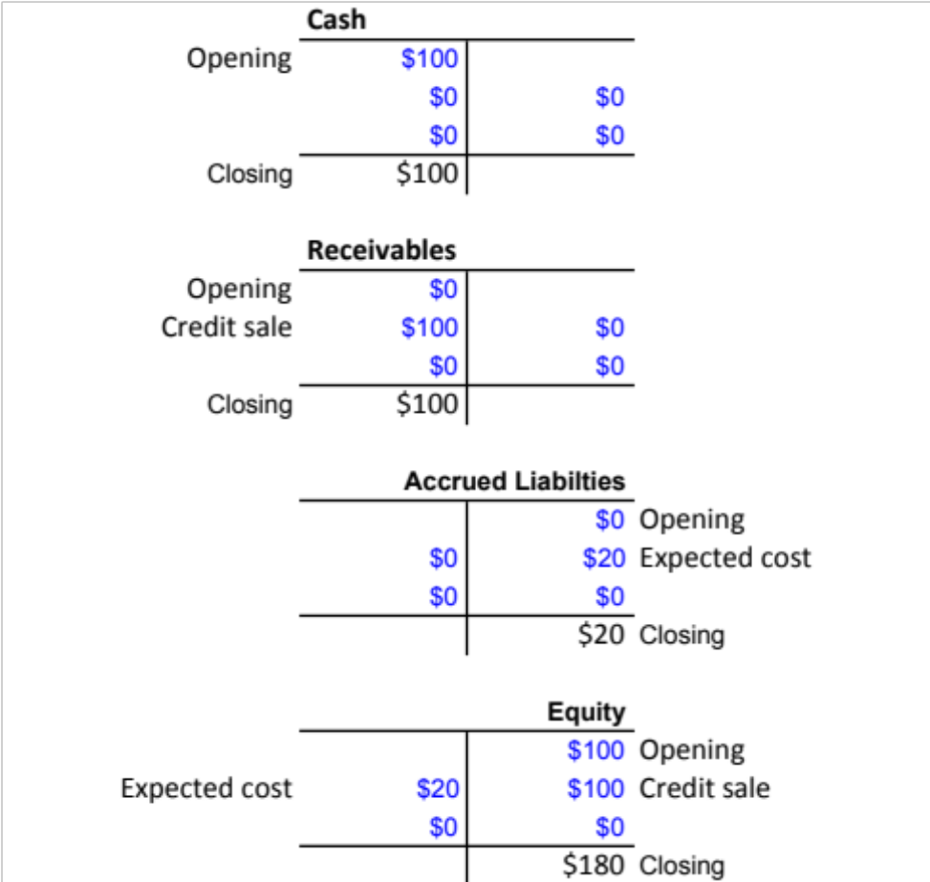
Revenue Recognition & Matching example
Credit sale & expected cost ... actual cost ... Collect
Match revenue (credit sale) and expense (expected cost)
Notes:
Many other examples, e.g hotel bill paid on departure but flights paid in advance. Staff paid during next month and bonus pool accrued during year but rent and insurance paid in advance. Bond coupons paid semi-annually but interest expense accrued until payment made. Taxes usually paid in arrears, accrue taxes owed.

Slide 8
Accrual v Prepay
ACCRUAL cash later
Accrued Revenue (post-pay) | Receivable |  | Cash
 |  | Equity (revenue) |  | Receivable
Accrued expense | Equity (expense) |  | Accrued Liability
 |  | Accrued Liability |  | Cash
PREPAY cash first
Unearned revenue (pre-pay) | Cash |  | Unearned revenue (liability)
 |  | Unearned revenue (liability) |  | Equity (revenue)
Prepaid expense | Current Asset (prepaid expense) |  | Equity (expense)
 |  | Cash |  | Current Asset (prepaid expense)
Notes:
This table diagrams the distinctive timing of prepaids and accruals. With prepaids the cash comes first. Then an adjusting entry is needed to update the accounts. Accruals start with an adjusting entry. Then, the cash transaction comes later.

Slide 9
Case study: Timing is everything
Accruals and Prepayments affect our Cash Flow, Income, Balance Sheet
Draw 2 profit opportunity cards and 1 hazard card
Start to prepare for your group presentation
  Part 1: The Runway
  Part 2: Growth and Income
  Part 3: The Exit

